Slide 1
Implementing and managing Azure networking
Overview of Azure networking
Configuring Azure virtual networks
Configuring Azure virtual network connectivity
Overview of Azure classic networking

Slide 2
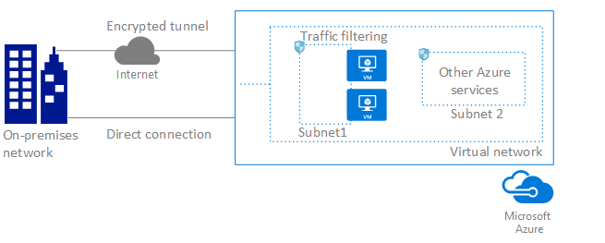
Overview of Azure networking
The Microsoft Azure Virtual Network service enables Azure resources to
securely communicate with other in a virtual network. A virtual network is a
representation of your own network in the cloud. A virtual network is a logical
isolation of the Azure cloud dedicated to your subscription. You can connect
virtual networks to other virtual networks, or to your on-premises network.
The following picture shows some of the capabilities of the Azure Virtual
Network service:

Slide 3
Implementing and managing Azure virtual networks
To create a VNet in the Resource Manager deployment model by using the Azure portal, follow the steps below. Use the example values if you are using these steps as a tutorial. If you are not doing these steps as a tutorial, be sure to replace the values with your own. For more information about working with virtual networks
From a browser, navigate to the Azure portal and sign in with your Azure account.
Click New. In the Search the marketplace field, type 'virtual network'. Locate Virtual network from the returned list and click to open the Virtual Network page.
Near the bottom of the Virtual Network page, from the Select a deployment model list, select Resource Manager, and then click Create. This opens the 'Create virtual network' page.

Slide 4
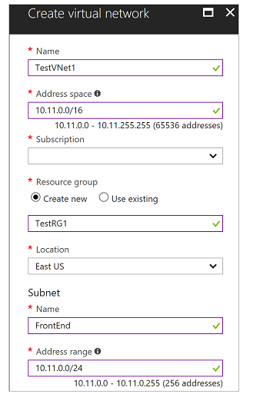

Slide 5
On the Create virtual network page, configure the VNet settings. When you fill in the fields, the red exclamation mark becomes a green check mark when the characters entered in the field are valid.
Name: Enter the name for your virtual network. In this example, we use TestVNet1.
Address space: Enter the address space. If you have multiple address spaces to add, add your first address space. You can add additional address spaces later, after creating the VNet. Make sure that the address space that you specify does not overlap with the address space for your on-premises location.
Subscription: Verify that the subscription listed is the correct one. You can change subscriptions by using the drop-down.
Resource group: Select an existing resource group, or create a new one by typing a name for your new resource group. If you are creating a new group, name the resource group according to your planned configuration values. For more information about resource groups, visit Azure Resource

Slide 6
Location: Select the location for your VNet. The location determines where the resources that you deploy to this VNet will reside.
Subnet: Add the first subnet name and subnet address range. You can add additional subnets and the gateway subnet later, after creating this VNet.
Select Pin to dashboard if you want to be able to find your VNet easily on the dashboard, and then click Create. After clicking Create, you will see a tile on your dashboard that will reflect the progress of your VNet. The tile changes as the VNet is being created.

